Slide 1
Mobile Application
Comprehensive User Guide for iOS
Table of Contents
Downloading the mobile application ………………………………………………………….1
Logging into the mobile application …………………………………………………………. 1
Quick Reference Guide …………………………………………………………………….....2-3
Messages ……………………………………………………………………………………….4
Composing a Message ………………………………………….........................................4-5
Responding to Messages ……………………………………………………………………..6
Message History ………………………………………….......... …………………………….7
Message Participants ………………………………………………………………………….7
Forwarding Messages …………………………………………………………………………8
Silencing Messages ……………………………………………...........................................9
Searching Your Messages ……………………………………………………………………10
Marking Your Message As Done …………………………………………………………….10-11
Directory ………………………………………………………………………………………...12
Contact Details ……………………………………………..................................................12
Searching and Filtering Options ……………………………………………………………...13
Creating a Group of Contacts ………………….….………………………………………….14
Editing Saved Groups …………………………….…………. ……………………………….15
Adding a Favorite ……………………………………….……………………………………..16
Schedule Group ……………………………………………….. ………………………...…...17
Broadcast Group ………………………………………………………………………...…….17
Take a Shift ………………………………………………..………………………………….. 18
Dialer ………………………………………..…………………………………………….…….19
Patients ………………………………………………………………………………………….20
Viewing Patient Details ………………………………………………………………………..20
Joining & Leaving a Patient’s Care Team …………………………………………………..21
Contacting a Patient’s Care Team ………………………………………………………......22
Associating a Patient with an Existing Message ………………………………………...…23
Associating a Patient with a New Message ……………………………………….........….24
News & Announcements ………………………………………………………….................25
Dark Mode ………………………………………………………………..…………………….25
Logging Out of the PerfectServe Clinical Collaboration Mobile App …………………..…26
FAQ | Support ……………………………………………………………………………….…27

Slide 2
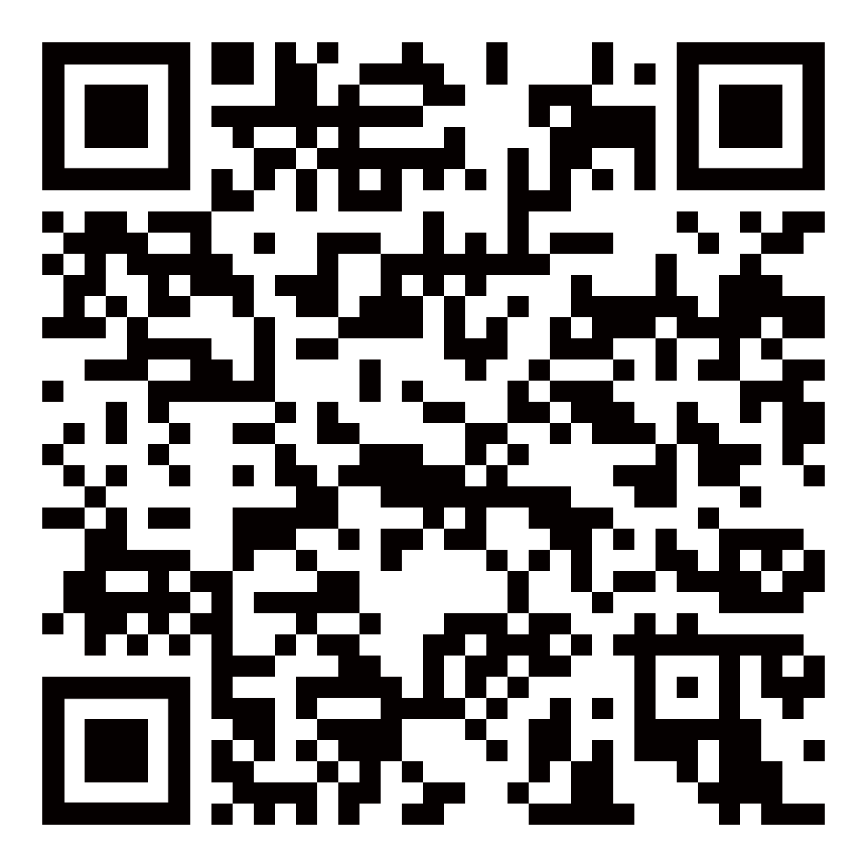
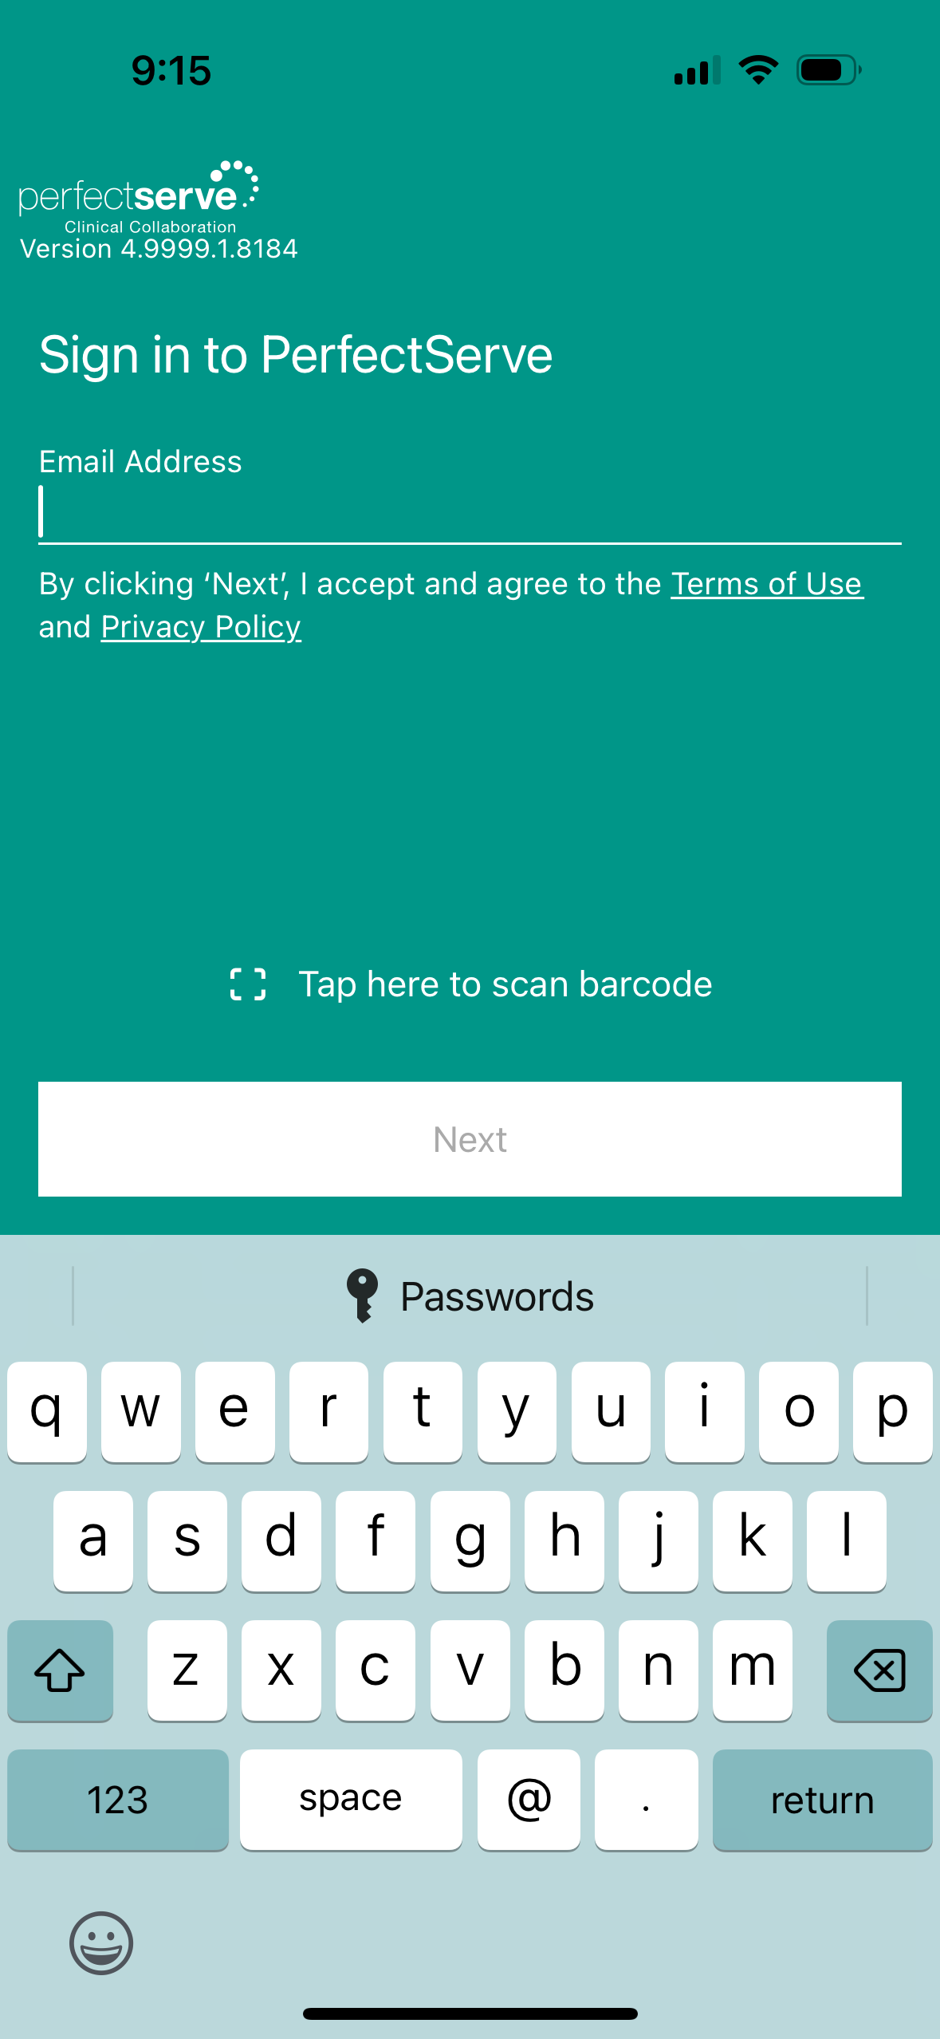
Downloading the mobile application
Open the App Store and search for PerfectServe Clinical Collaboration.
͏Download͏ the application.
Once installation is complete, select OPEN.
Scan the QR code to navigate directly to the application in the App Store.
Logging into the mobile application
Sign in using your PerfectServe Clinical Collaboration credentials.
If unsure what to enter, contact your PerfectServe Clinical Collaboration administrator or Support at 877-844-7727 x1.
͏Enable Biometric Sign In
Users have the option to enable this feature or proceed without it.
Create a PIN.
Re-enter the PIN to confirm.
All personal information will remain confidential and secure, neither shared nor sold. View our privacy policy at www.telmediq.com.
1

Slide 3
Complete Control At Each User’s Fingertips
Messages
Read, reply, and create secure text and voice messages with attachments. Access current or archived messages with a swipe of the toggle.
Patients
View your patient(s) or all patients and care team assignments. Join/leave a patient’s care team. Initiate messages regarding the patient to their entire care team or a specific individual.
Directory
Locate providers and staff, view schedules, and confirm who is on-call.
News
See informational announcements and news broadcasted from your facility.
Dialer
Dial the phone number of the individual you wish to reach. Your facility’s dispatch number will display instead of your personal number, so your privacy is protected.
2

Slide 4
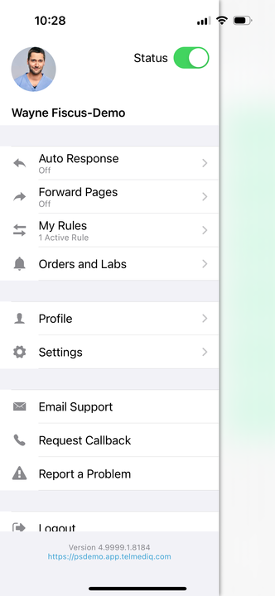
Complete Control At Each User’s Fingertips continued
Status
Adjust your status from ‘online’ to ‘do not disturb’ with a quick toggle.
Reach*
Connect with patients and their family members via messages or video direct to their personal devices.
Auto Response
Enable a predefined or custom automatic response to messages received.
Profile
View your personal profile, change your photo or edit your first/last name.
Forward Pages
Enable message forwarding to another individual or broadcast group.
Settings
Customize your alert, call, message, and security settings.
My Rules
Enable rules that can be used to provide an auto response and forwarding of messages for a specific timeframe.
Email Support
Contact PerfectServe Clinical Collaboration Support through email.
Request Callback
Contact PerfectServe Clinical Collaboration Support through a phone call and request a callback for assistance.
Orders and Labs
Enable and set priorities or statuses to receive orders and lab notifications for patients.
*This is an add-on module that may not apply to your facility.
3

Slide 5
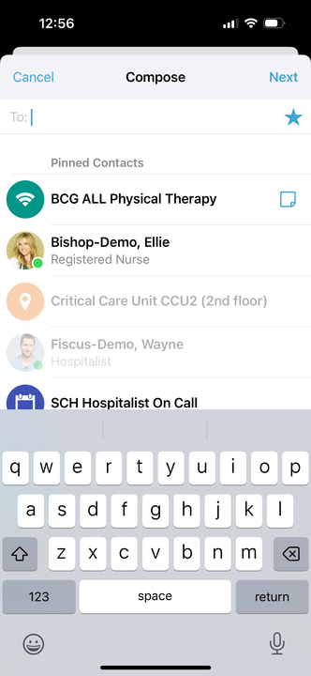
Comprehensive User Guide for iOS
Messages
The Messages tab is where all messages are accessed.
Select Messages to see a list of your existing messages, or to start a new one.
Along the left side of the Messages are icons that designate message status.
Composing a Message
To start a new conversation:
Select the new message icon in the upper-right corner.
To find the person you wish to reach, you can use Search, Pinned Contacts, My Favorites, Local Groups, or Recently Contacted to quickly find your desired recipient.
To Search, type the name of the person or broadcast group you wish to reach in the Search bar. Search results update automatically as you type.
Icon | Message Status
 | Unread
 | Urgent Unread
 | Sent
 | Replied
4

Slide 6
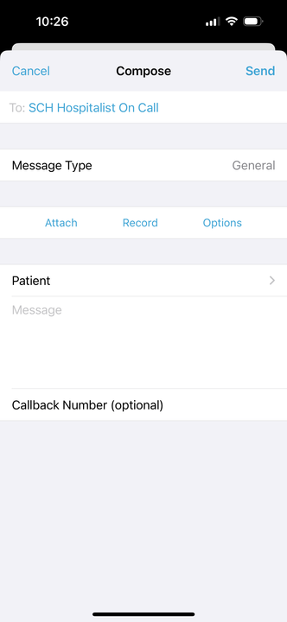
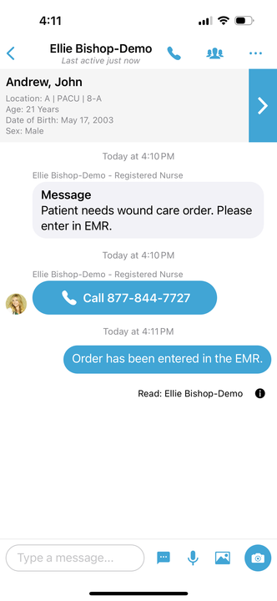
Comprehensive User Guide for iOS
Composing a Message continued
͏͏͏Select the message type you need to display the message template.
Message fields will change based on the template selected.
Select Attach to attach photos to your message, Record to attach a voice memo, and Options to access the message options.
͏Attach = Access your phone’s camera to take and attach a picture. You can also select to attach an existing photo from your phone’s photo library. Images will not save on the phone and are stored on ’s secure platform to ensure HIPPA.
͏Record = Record and send an audio message. Audio messages will not save on the phone and are stored on ’s secure platform to ensure HIPPA.
͏Options = Display message options such as allow replies or reply notifications to toggle them on/off if available.
When finished, click Send.
At the top of the message, you will find the date and time you sent the message. At the bottom, you will find the Sent/Read status of your message.
3
5

Slide 7
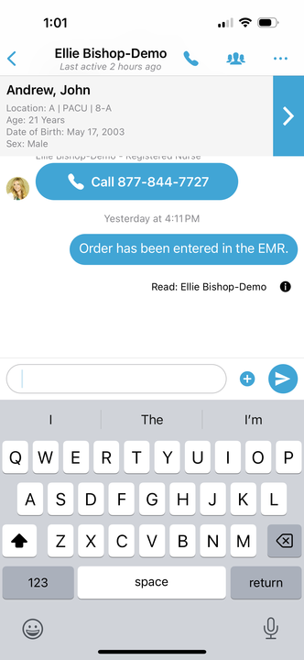
Responding to Messages
Select the conversation you wish to respond to in your Messages.
To reply via text, tap the Type a message field to start typing your message. When finished, press Send.
Camera = Access your phone’s camera to take and attach a picture.
Photo = Access your phone’s library to attach a saved picture.
Record = Record and send an audio message.
Quick Response = Select a templated quick response message to send.
To reply via a call, press the blue phone icon next to the sender’s name and select Call.
3
3
7
2
6

Slide 8
Message History
͏͏Long-press the message. It can be the text, photo, or even audio.
Select Message History.
The message status of each recipient will be listed, along with the date/time stamp indicating when the message was delivered.
Message Participants
Select the Participant icon.
A list of message participants will display. Contact any participant by selecting their name.
Additional participant(s) may be added by pressing the +.
7
7

Slide 9
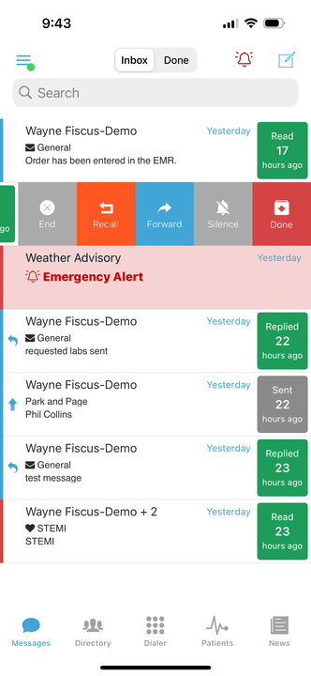
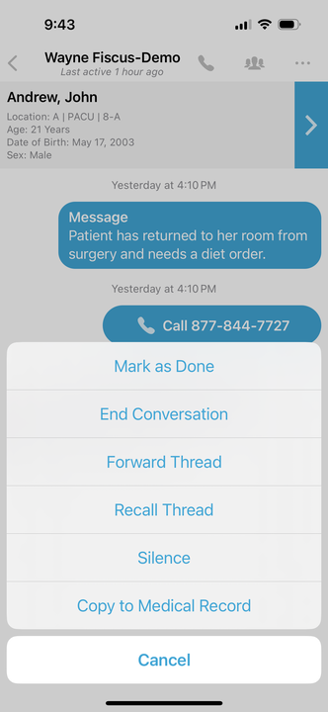
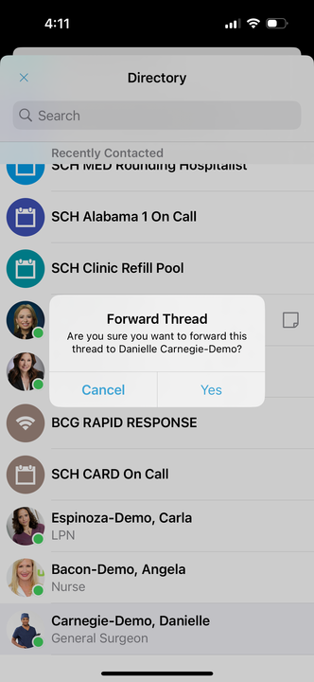
Forwarding Messages
There are two ways that you can forward a message thread in the PerfectServe Clinical Collaboration mobile application.
From the main Messages tab, swipe the message to the left; select Forward.
Inside the message, select the three ellipses in the upper-right corner; select Forward Thread.
To forward a single message within the thread, long-press the message; select Forward Message. You can forward text, audio, or photos.
͏Search for the person to send the message to.
͏Click on the recipient’s name.
Select Yes to confirm that you want to forward the message thread.
8

Slide 10
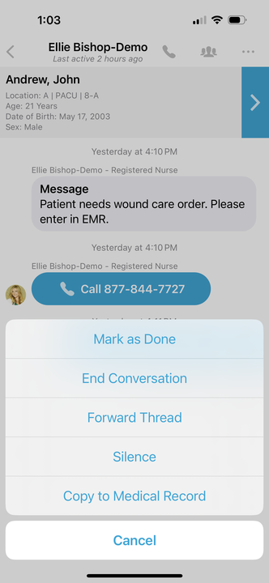
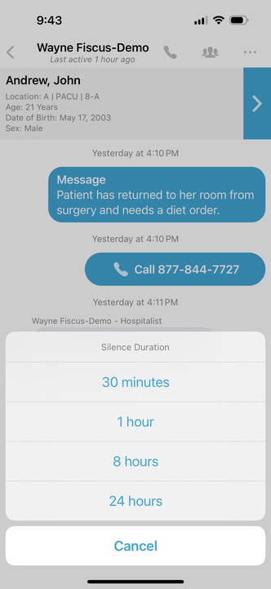
Silencing Messages
To stop all alerts for a specific message, you can silence the message.
From the main Messages tab, swipe the message to the left; select Silence.
Inside the message, select the three ellipses in the upper-right corner; select Silence.
Select the amount of time you wish the silence your alerts.
10

Slide 11
Searching Your Messages
The top search bar allows you to search your Messages for a specific message.
Marking Your Message As Done
When you no longer need the message to be active in the Inbox tab of your Messages, you can now archive them to the Done tab of your Messages.
From the main Messages tab, swipe the message to the left; select Done.
Note: A message must be read before it can be marked as done.
11

Slide 12
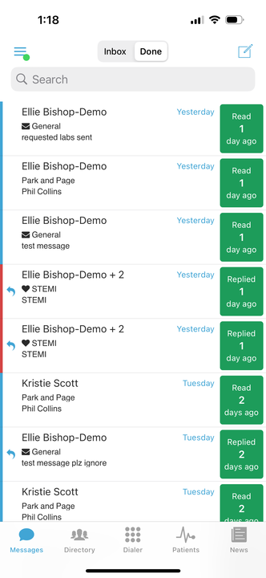
Marking Your Message As Done continued
All messages marked as done can be found in the Done tab of your Messages.
Note: A message be read before it can be marked as done.
12

Slide 13
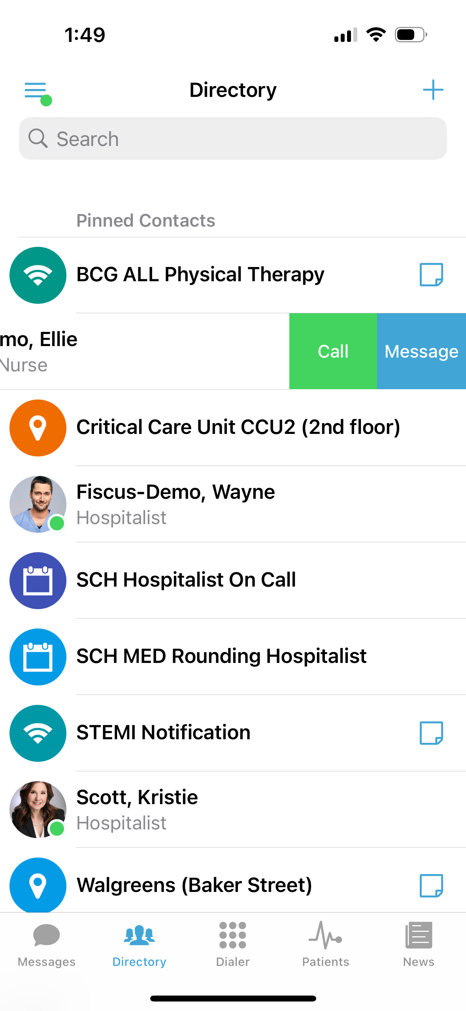
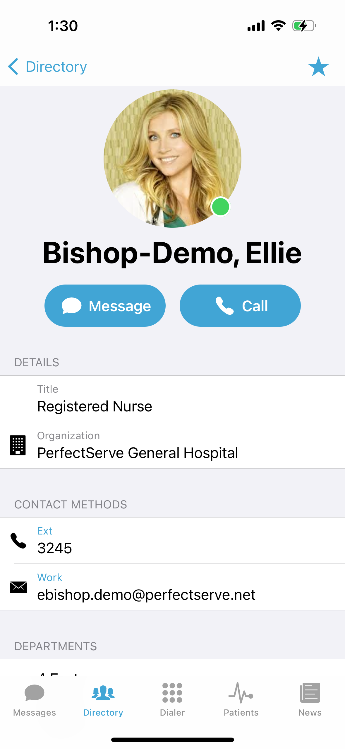
Directory
The Directory tab is where all contacts and groups can be accessed.
Select Directory to see the full list.
Along the left side of each contact are icons that designate the type of contact.
͏Pinned Contacts are contact favorites indicated for an individual, a specific department, or assignable role.
͏My Favorites are contacts marked as favorites from inside the directory tab by the user.
͏Local Group are personal groups created by the user and are only seen in the directory tab of their mobile application
͏Recently Contacted are contact you recently contacted either through message or call.
͏Notes are indicated on the far right of each contact with a icon, if there are any.
͏Swipe left on a contact to instantly call or compose a message.
͏Tap on a contact to preview the contact’s details.
Contact details
Inside the contact’s detail you can review the following:
Title
Organization affiliation
Department(s) the user belongs to, if any
Contact methods and notes
Select message to begin composing a message to the contact.
Select call to initiate a call to the contact.
Icon | Message Status
 | Schedule Paging Group
 | Broadcast Paging Group
 | Group
13

Slide 14
Searching and Filtering Options
Find a contact you need quickly and easily with search and filters. You can use any of these features independently, or you can combine them.
Begin to search for a contact so that the Filter option will appear; select Filter.
Select Add Filter to narrow results by Alias, Credentials, Department, Location, Market, Specialty, Title, or Type.
Continue to add as many additional filters as needed.
Click Save once all filters have been selected.
Name the new filter so that it can be used easily in the future.
When finished, click Save.
The filter will appear under the search bar when in use.
When the filter is not needed, click the filter; and toggle the saved filter off.
6
2

Slide 15
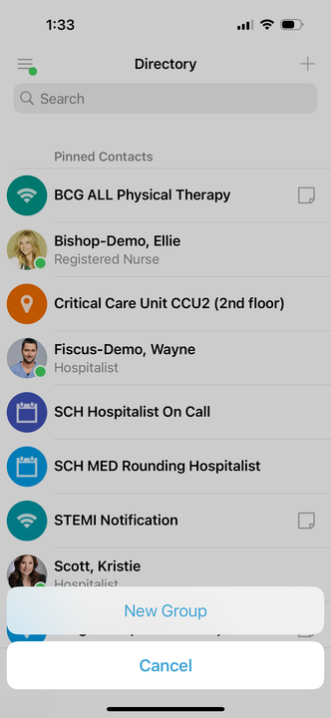
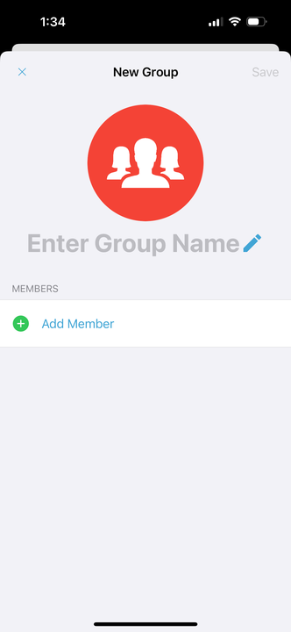
Creating a Group of Contacts
To create a Group, click Directory; then, select the Add symbol.
Select New Group.
͏͏Name your group.
Select Add Member and add recipients by searching for each contact individually; select their name to add them to the group.
When finished, click Save.
Your new saved group will appear under “Local Groups”.
3
3

Slide 16
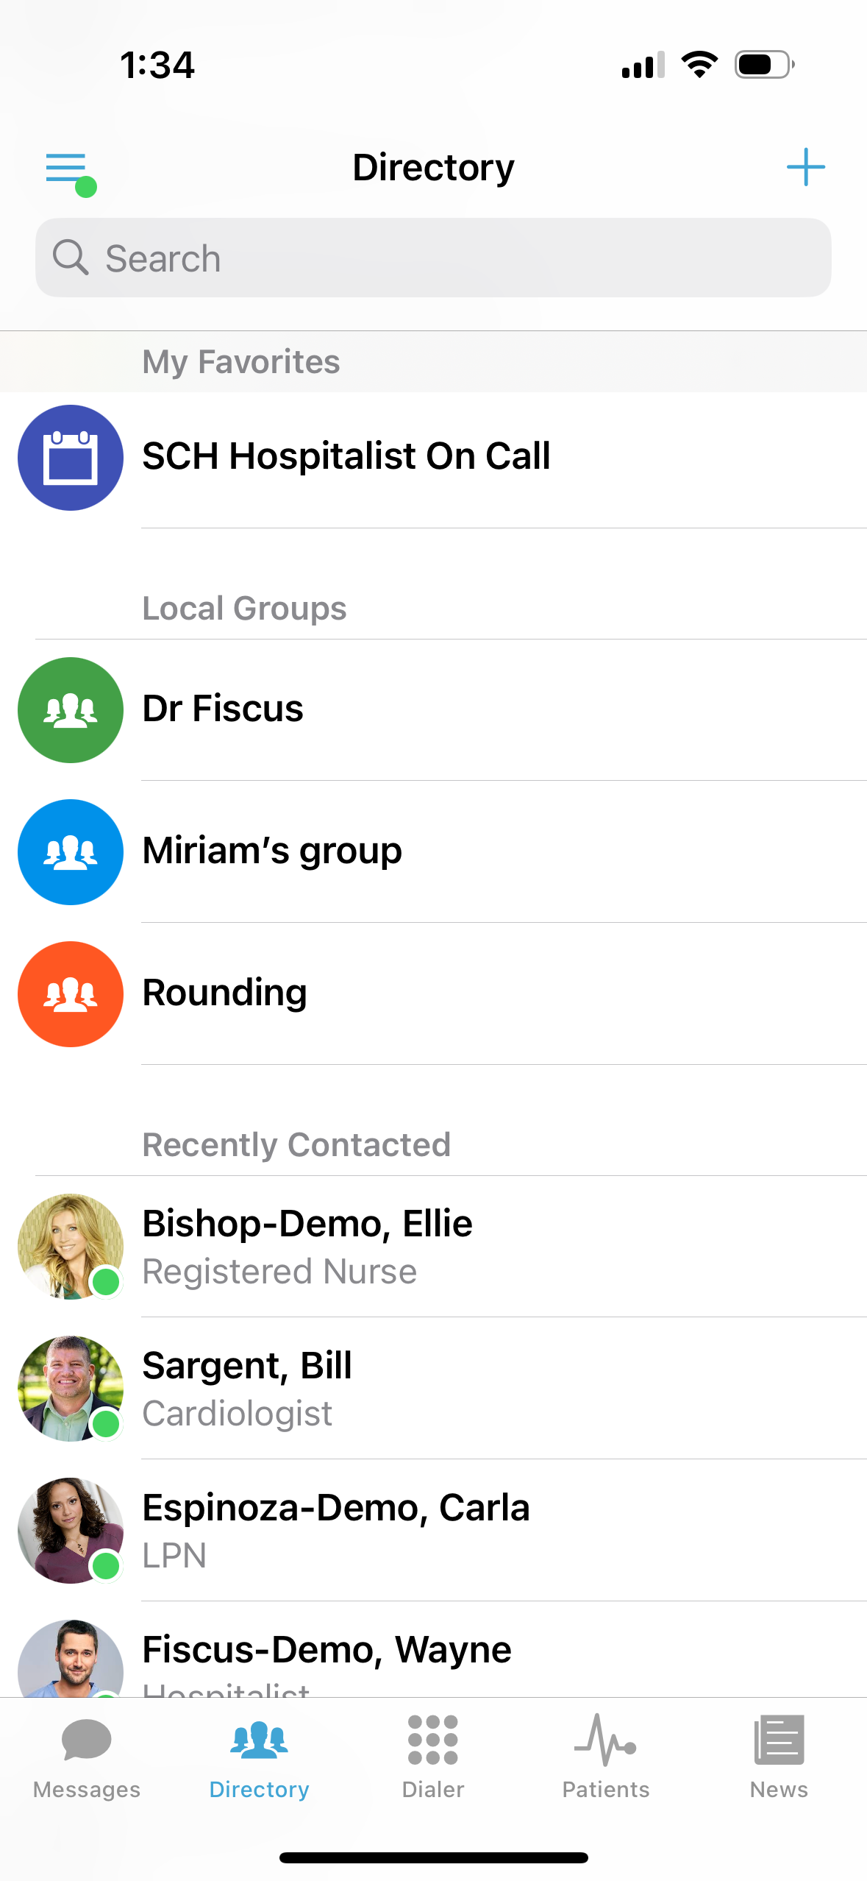
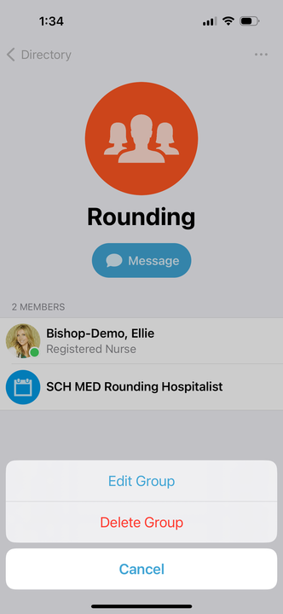
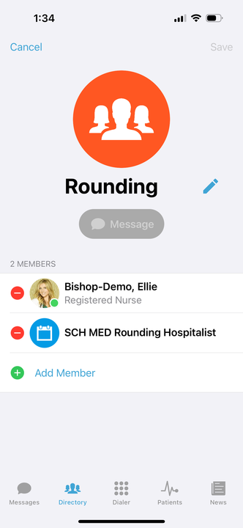
Editing Saved Groups
Select Directory, scroll to Local Groups and select the group you want to edit.
Select the three ellipses in the upper-right corner; click Edit Group.
To change the name of the group, select the pencil next to the current name and use the keyboard to edit.
To add a new group contact, select the Add Member.
͏Search for and select desired recipients.
To remove a group member, tap the icon; select Delete.
When finished, press the Save button in the upper-right corner.
4

Slide 17
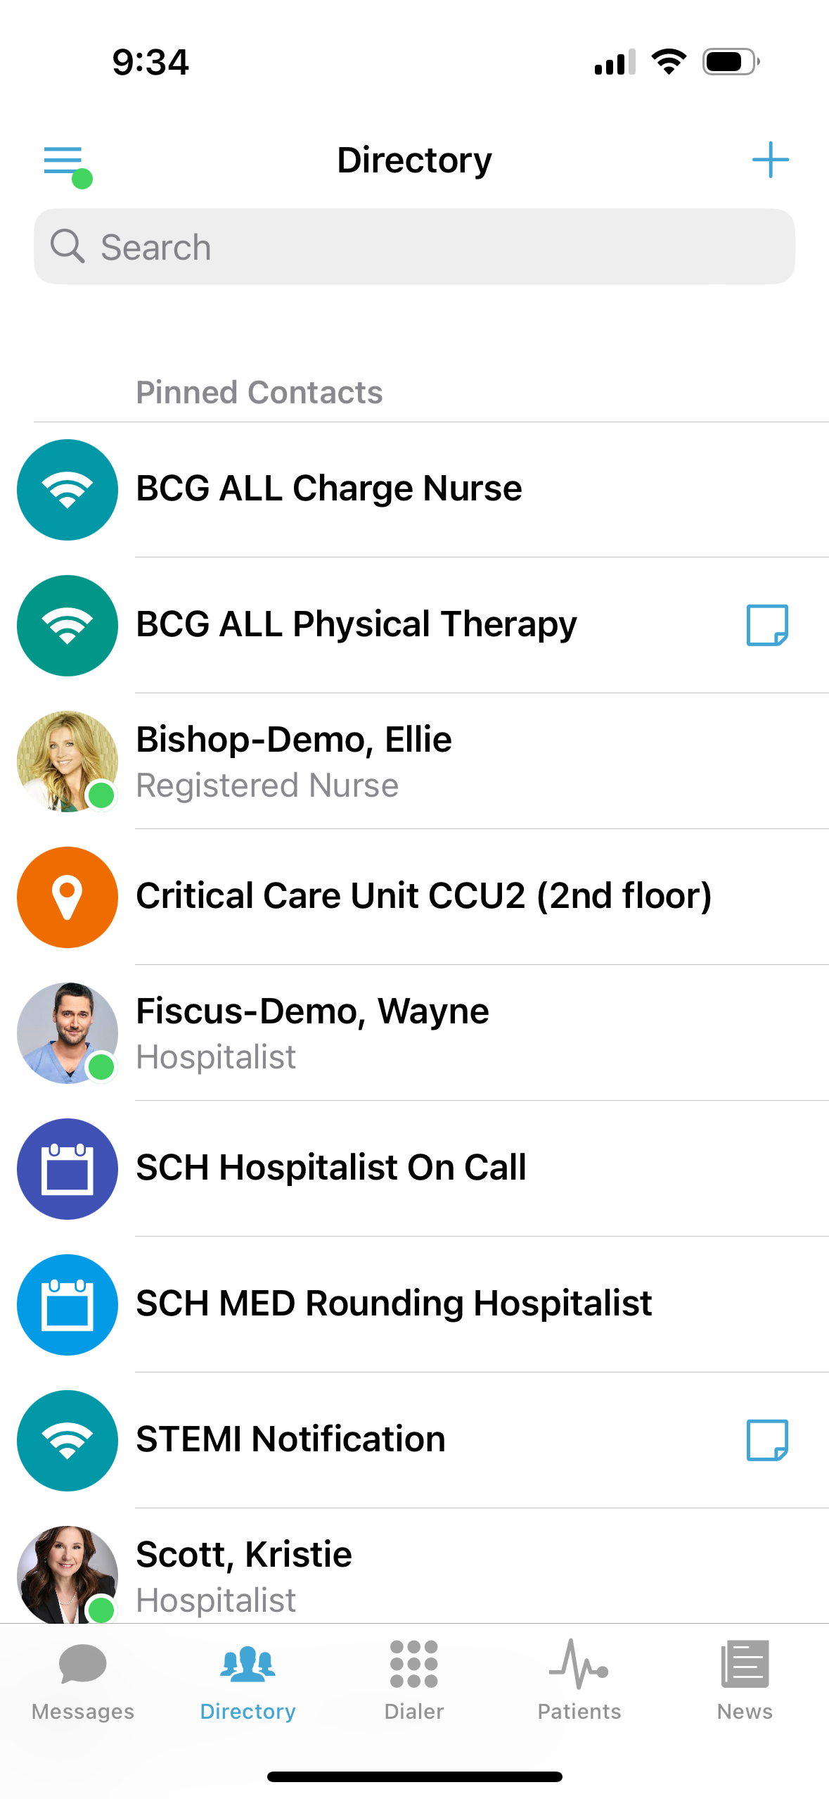
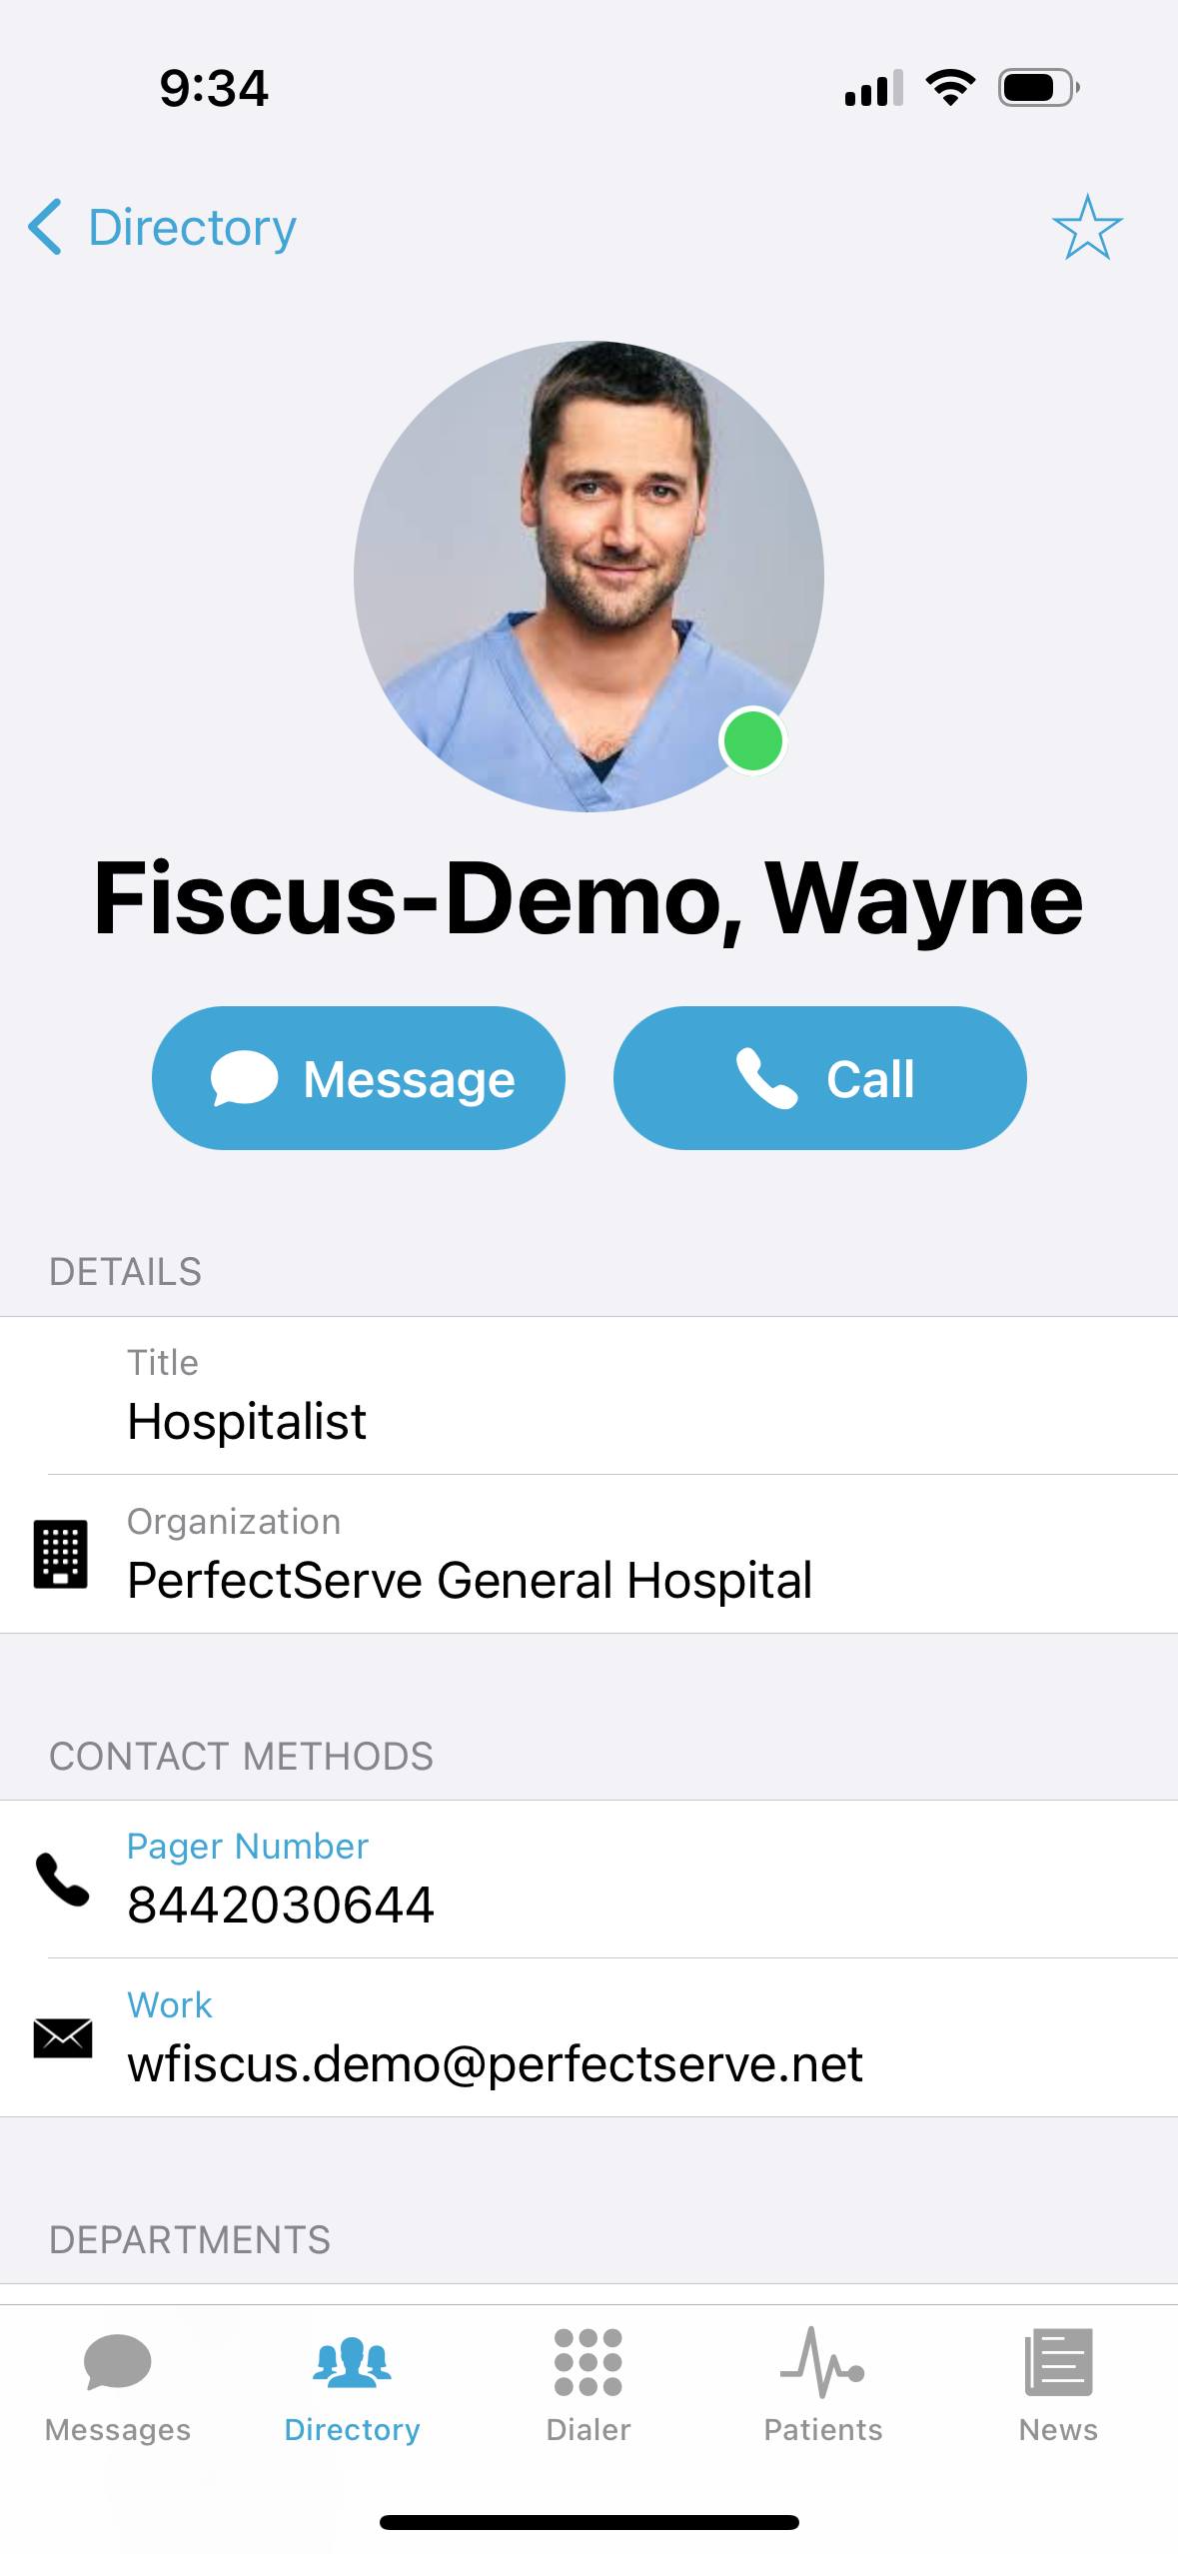
Adding a Favorite
Favorites allows you to create a shorter list of your most frequently contacted. To add a favorite:
Within the Directory, search for the contact.
Click on the contact to open the contact’s details.
Click the star icon in the top right corner.
To view and contact a Favorite, scroll to the My Favorites in the Directory tab.
17

Slide 18
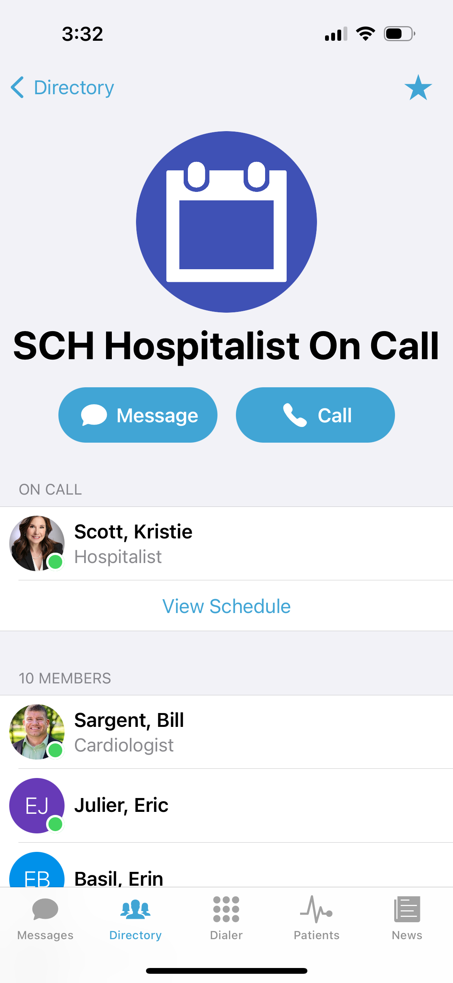
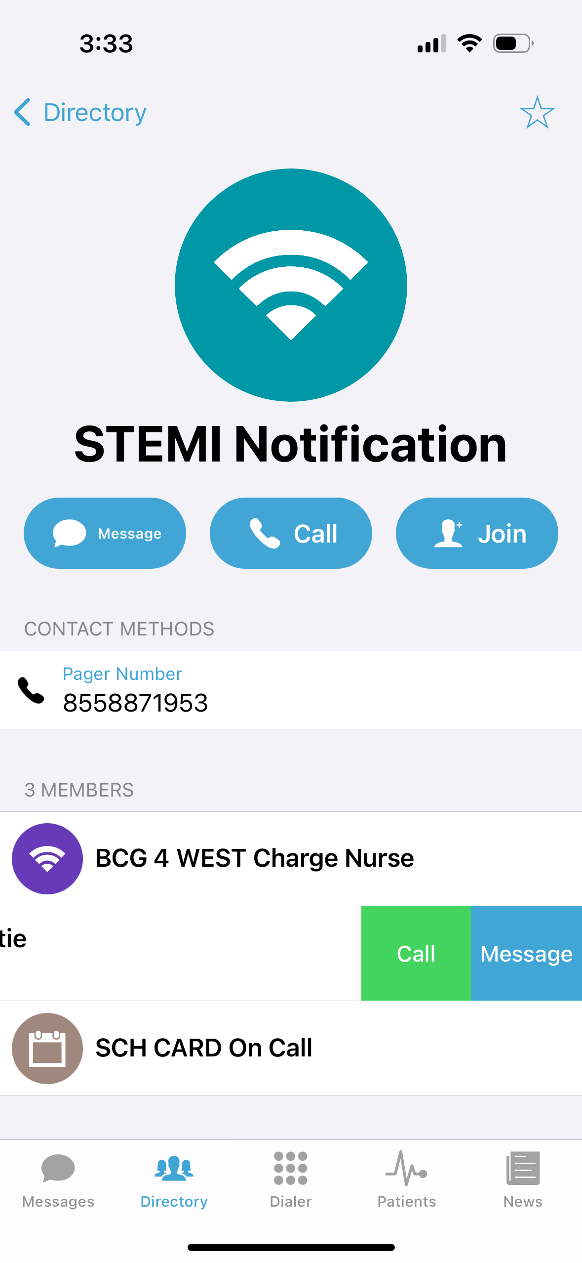
Schedule Group
On Call gives you access to view who is covering call. You may have one or many schedules to choose from and all changes are applied immediately
On-Call – Indicates who is covering call
Members– A list of all members that cover call.
View Schedule – See a view of the current schedule.
Favorite – Mark the schedule group as a favorite so that it appears in your Favorites of your Directory tab.
Broadcast Group
Broadcast Group is a paging group with a list of members to whom the message(s) can be sent at once. It works like a distribution list in any Enterprise email account
Message – Message all members in the broadcast group
Call– Call all members in the broadcast group.
Join – Allows you to join the broadcast group
Members – A full list of all contacts currently in the broadcast group.
Favorite – Mark the broadcast group as a favorite so that it appears in your Favorites of your Directory tab.
Swipe left on a member’s name to call or message that contact only.
3
6

Slide 19
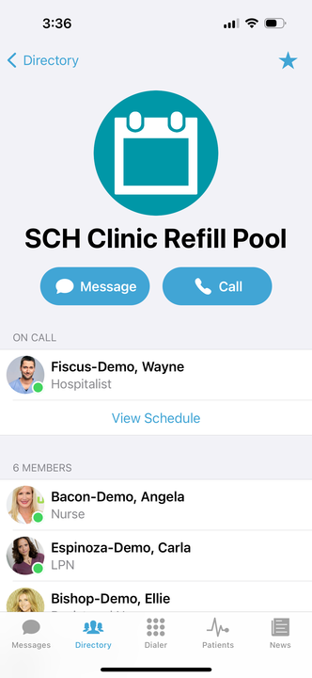
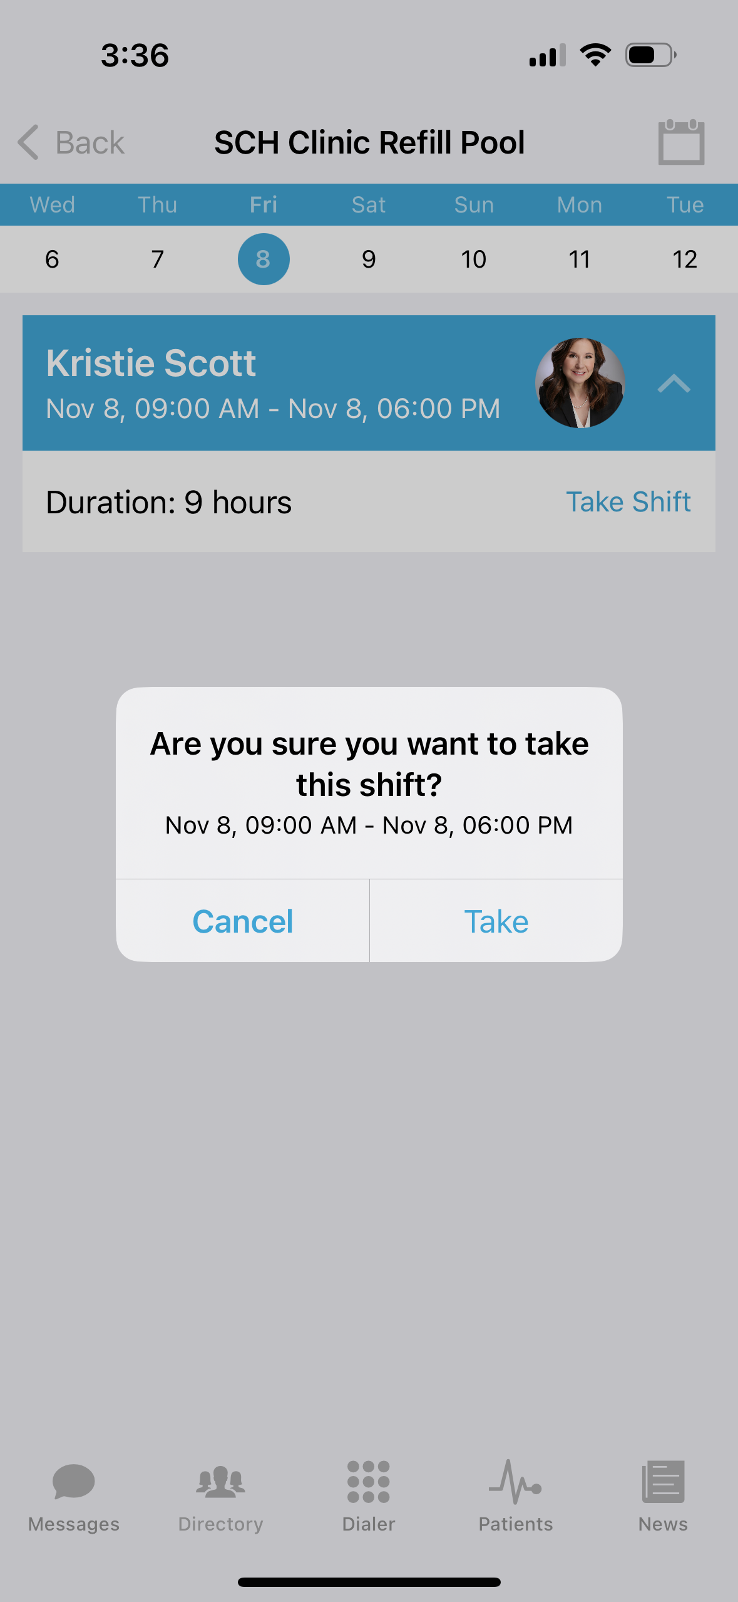
Take a Shift*
*This feature will only appear if the option is turned on for the schedule group.
Select Schedule Group you wish to view.
Select View Schedule.
͏͏Select the date.
͏͏Click on the slot you wish to take.
Select take shift.
Click Take to confirm that you want to take the shift.
7

Slide 20
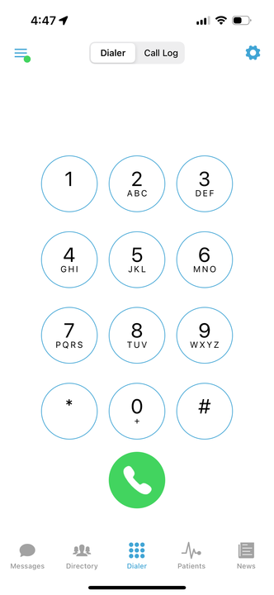
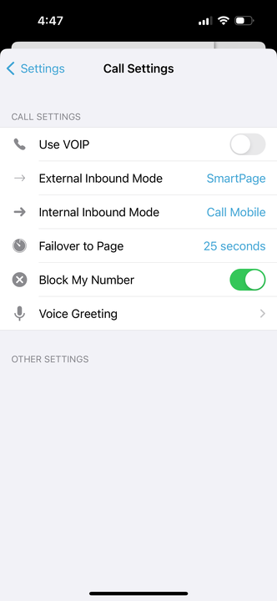
Dialer
This feature provides a secure method for you to place outbound calls to patients and other providers.
Keypad – Free form keypad to dial any 10-digit number
Call log – A list of all recently dialed numbers
Settings – Adjust your call settings preferences
PerfectServe Clinical Collaboration believes in protecting the privacy of the practitioners we serve. Therefore, to activate the caller ID mask functionality, all calls must be routed through the PerfectServe Clinical Collaboration exchange. Whether you use the keypad in Dialer or choose a contact by name, PerfectServe Clinical Collaboration will display your account’s assigned dispatch number as the number you are calling. This indicates that the call is routing through the exchange to protect your ID.
3
Note: All calls placed through the PerfectServe Clinical Collaboration mobile app protect your caller ID.
21

Slide 21
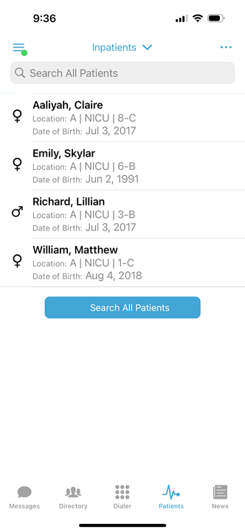
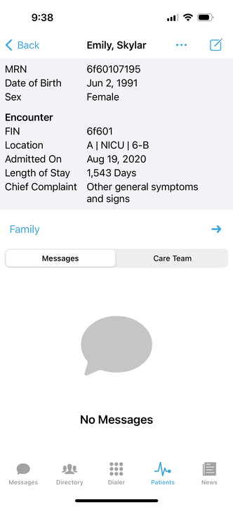
Patients*
*This option is only available to users who are given the proper privileges by their facility admin.
Within Patients, you can see patient details, access messages, notes, updates, contact members of the care team, and join or leave a patient’s clinical team just by knowing the patient’s name.
Viewing Patient Details
Select Patients.
Search for the patient to view the patient’s clinical team
My Patients is the main view and shows patients that have you assigned on their clinical team.
Search All Patients to locate a patient that does currently have you as part of their clinical team.
Sort allows you to sort your view by name or location.
͏͏͏Select the patient from either Inpatients or from the search results in Search All Patients.
In the patient you will see the following information:
Patient Information (e.g., MRN, DOB, Sex, and Encounter details).
Messages – all messages pertaining to this specific patient.
Care Team – all members of the clinical team assigned to the patient.
3
22

Slide 22
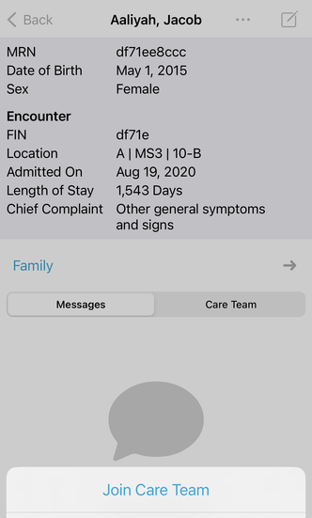
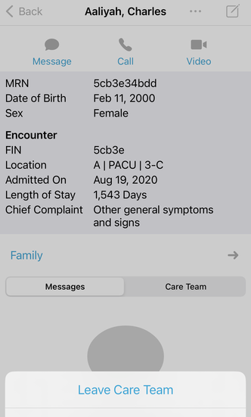
Joining a Patient’s Care Team
Select Patients.
Search for the patient to view the patient’s clinical team using the Search bar or by clicking Search All Patients, then entering the patient’s name.
͏͏Swipe left on the patient’s name; select Join.
If you wish to confirm the patient’s details prior to joining; select the patient.
Click the three ellipses and select Join Care Team.
Leaving a Patient’s Care Team
Select Patients.
Locate the patient in your Inpatients.
͏͏Swipe left on the patient’s name; select Leave.
If you wish to confirm the patient’s details prior to leaving; select the patient.
Click the three ellipses and select Leave Care Team.
3
23

Slide 23
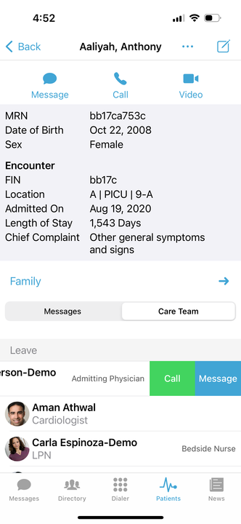
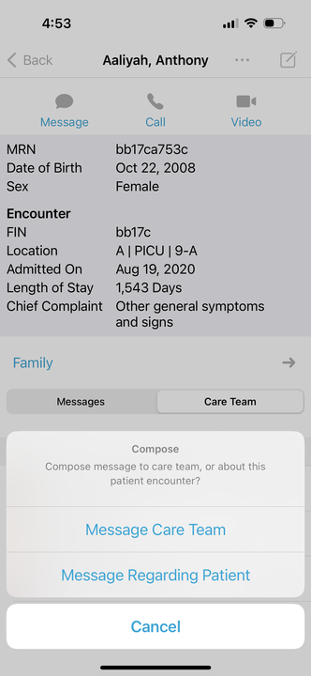
Contacting a Patient’s Care Team
Select Patients.
͏͏Select the patient.
Click Care Team in the patient’s detail view.
To contact just one individual of the Care Team:
͏Swipe left on the individual’s name; select contact method.
To message the entire Care Team:
Select the compose icon in the top right corner; select Message Care Team
To message a contact other than those listed in the Care Team:
Select the compose icon in the top right corner; select Message Regarding Patient.
3
24

Slide 24
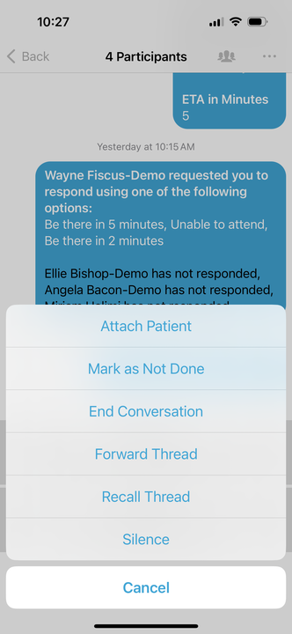
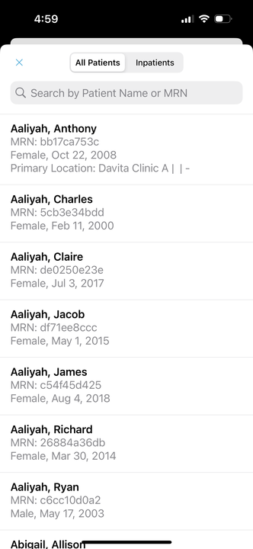
Associate a Patient with Existing Message
Select Messages.
͏͏Select the existing message.
Select the three ellipses in the top right corner; select Attach Patient.
Select the patient.
The patient’s information will appear at the top of the message.
3
25

Slide 25
Associate a Patient with a New Message
Select Messages.
͏͏Compose a new message.
͏͏Select a message type that has a patient centric field.
Select the patient field.
͏͏͏͏Select the patient.
Complete the message; then send.
3
26

Slide 26
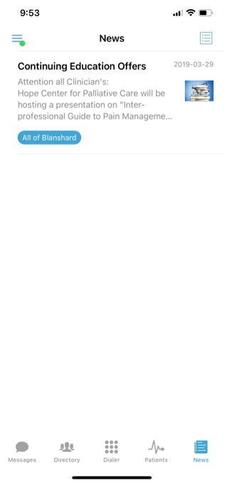
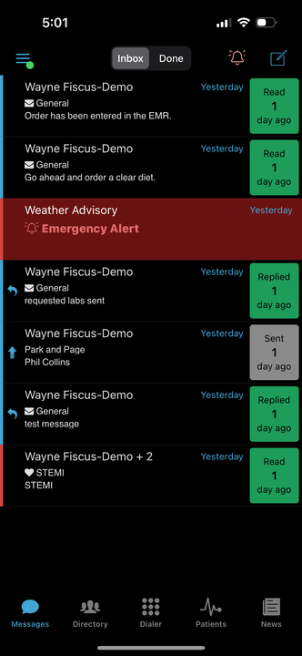
News & Announcements*
*This feature will only appear if the option is being used by your facility.
The News & Announcements section provides the ability to broadcast information out to specific users, departments or to the entire account. Information shared in these feeds are typically informational and are not critical in nature.
Select News.
͏​​Select the message to view.
Select the blue bell icon in the top right to turn alerts on/off for any messages in the News & Announcements tab.
Dark Mode
The PerfectServe Clinical Collaboration mobile application will appear in dark mode whenever the phone’s settings appearance display is set to dark mode as well.
27

Slide 27
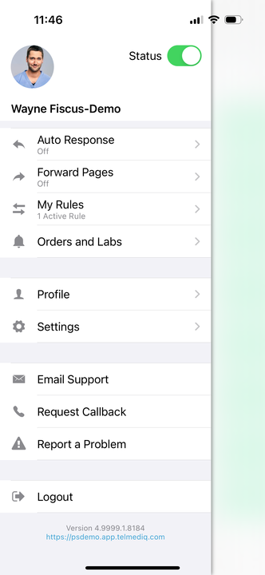
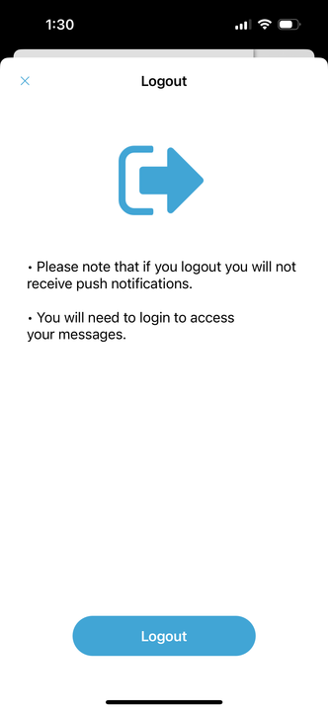
Logging Out
To logout of the PerfectServe Clinical Collaboration application, select Logout from the main menu.
The PerfectServe Clinical Collaboration application will display a confirmation window.
Select Logout to proceed or exit the confirmation window to cancel.
All personal information will remain confidential and secure, neither shared nor sold. View our privacy policy at www.telmediq.com.
28

Slide 28
Frequently Asked Questions
Will my organization have a single point of contact within Support?
All PerfectServe Clinical Collaboration clients are supported by a shared pool of resources within a tiered support desk model. By utilizing internal best practices and a communal knowledgebase, we can standardize our support across multiple resources and clients to provide the most efficient service possible for our users.
͏What are PerfectServe Clinical Collaboration’s Support hours?
PerfectServe Clinical Collaboration’s support is available 24/7, 365 days.
How To Contact PerfectServe Clinical Collaboration Support
1.877.844.7727 x1
Support@Telmediq.com
https://support.telmediq.com/hc/en-us
Open PerfectServe Clinical Collaboration Mobile Application. Expand the side menu and select Email Support or Request Callback.
29
7.2021

