Slide 1
Mobile Application
Mobile App Overview for iOS
Complete Control At Each User’s Fingertips
Messages
Read, reply, and create secure text and voice messages with attachments. Access current or archived messages with a swipe of the toggle.
Directory
Locate providers and staff, view schedules, and confirm who is on-call.
Dialer
Dial the phone number of the individual you wish to reach. Your facility’s dispatch number will display instead of your personal number, so your privacy is protected.
Patients
View your patient(s) or all patients and care team assignments. Join/leave a patient’s care team. Initiate messages regarding the patient to their entire care team or a specific individual.
News
See informational announcements and news broadcasted from your facility.
*Select the three (3) lines to expand an additional list of menu options (shown on page 2).

Slide 2
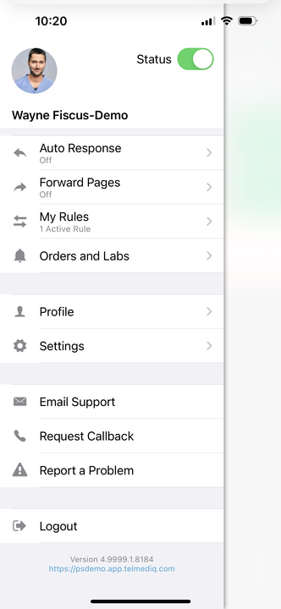
Complete Control At Each User’s Fingertips continued
Status
Adjust your status from ‘online’ to ‘do not disturb’ with a quick toggle.
Auto Response
Enable a predefined or custom automatic response to messages received.
Forward Pages
Enable message forwarding to another individual or broadcast group.
My Rules
Enable rules that can be used to provide an auto response and forwarding of messages for a specific timeframe.
Orders and Labs
Enable and set priorities or statuses to receive orders and lab notifications for patients.
*This is an add-on module that may not apply to your facility.
Reach*
Connect with patients and their family members via messages or video direct to their personal devices.
Profile
View your personal profile, change your photo or edit your first/last name.
Settings
Customize your alert, call, message, and security settings.
Email Support
Contact PerfectServe Clinical Collaboration Support through email.
Request Callback
Contact PerfectServe Clinical Collaboration Support through a phone call and request a callback for assistance.
Report a problem
Contact PerfectServe Clinical Collaboration Support by sending a report and log file when an issue was experienced while in the mobile app.

