Slide 1
Web Console
Paging Groups
Overview
This Paging Groups section will be replacing the legacy Paging Groups tab. From here you can create new and manage existing groups. There is also a feature called Scheduler that allows you to select multiple schedule groups to see who on-call is currently.
Adding a Paging Group
Click the +Add Paging Group button in the upper right corner and fill in the following details
Name: Consider using a standardized naming convention
Group Type: Choose from Schedule or Broadcast Group
Failover Target: This user or group will be messaged if no one is scheduled or the broadcast group has no members
Manage Groups
This option will show all paging groups.
Name: The preceding icon indicates if it is a Broadcast group or Schedule Group
Department: Indicates if a department has been assigned to this group
Escalation Policy: Indicates if an escalation policy has been applied to this group
Delete: This icon will allow you to delete a paging group
By clicking the name of a group, you will enter the group’s settings page.
Schedule Group Details
Calendar View - Can be set to Day, Week, or Month. You can add an event from here or view all existing events.
Adding an Event
Click and drag the desired time slot for your event. An Add Event page will appear after you release the mouse button.
Available Fields:
All Day : Check box
From: Indicate date and time for the beginning of your event
To: Indicate date and time for the end of your event
Repeat: Checkbox. You can select your repeat pattern and end date

Slide 2
Schedule Group Details continued
User/Group: Select the person or group who will be taking call at this time
Escalation Policy: This can be set on an individual event basis. If no policy is selected, the group’s escalation policy, if available, will apply to all events.
Public Link
To share the link, navigate to the Paging Group. Select "Public Link" and copy the URL from the browser.
This link is accessible for PerfectServe Clinical Collaboration users and the public alike. Can be useful for sharing a read-only view of the schedule with other facilities or clinics if so desired.
Print Schedule
The "Print Schedule" button initiates the printing of the schedule based on the currently selected view.
Select "More Settings" to expand in the print view to adjust the layout and scaling of the schedule prior to printing.

Slide 3
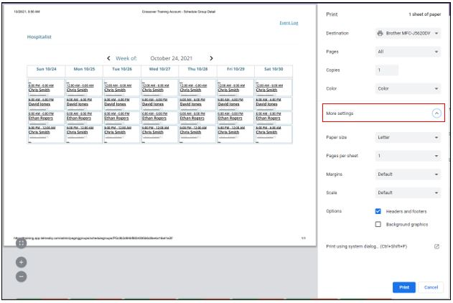
Print Schedule continued
Saving PDF version of schedule by selecting the "Print Schedule" button. Change the destination from your local printer to "Save as PDF".

Slide 4
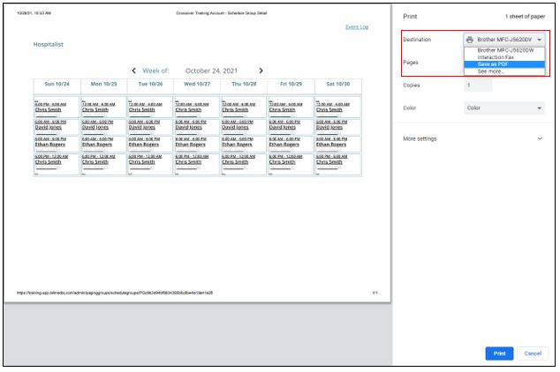
Print Schedule continued
You can screen capture the schedule and distribute the image.
Windows: Windows Key + Shift + S will activate the Snip & Sketch tool. Use your mouse to click and drag over the area you want to capture.
Mac: Shift + Command + 4. Use your mouse to click and drag over the area you want to capture.

Slide 5
Schedule Group Settings
Name: Free text field
Contact ID: This read only unique ID can be used to send emails from outside systems to this group (Example: CO48ef8d085eac48f2906a92b7d3b@example.app.telmediq.com)
Shift Takeover: Allow the takeover of shifts on this schedule by other users.
Department: Assign a department to the group
Failover Target: When nobody is on call all pages will go to this target.
Escalation Policy: The default escalation policy if not specified for an individual event.
Incoming Call Handling: Configure what happens when someone calls this group. If a group has only a single user, that user's individual call settings will override these.
Enumerate Users: When multiple users are on call, allow the caller to select a member to contact
Message All: Collect a voice message and send to all group members
Call All Voice Users: Simultaneously ring all members, and connect to the first to pick up
Greeting: The greeting to play when the group is paged. The group greeting will always play when multiple users are being messaged.
Online Greeting: Choose from a dropdown.
Offline Greeting: Choose from a dropdown.

Slide 6
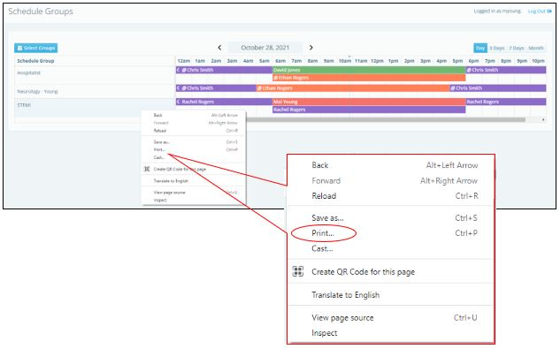
Scheduler
Admins can use this page to add or edit events easily for multiple groups. Add an event by clicking and dragging the desired duration. Edit existing event details by clicking on the event itself.
Select Groups: This button allows the user to select which groups they want to view
Date View: Select from Day, 3 Days, 7 Days, or Month
To print from the scheduler view, right-click from your mouse and select "print".
Event Logs
View all the paging group events here. These event logs will show all the changes to the paging groups, including what was included in the change, who made the change, and the date/timestamps of this change.

